Slide 1
Supplemental Payroll
Serena Owsley Athens City Schools AASBO – May 2018
Robbie Beason Retired CSFO
Jennifer Hornsby Pike County Schools

Slide 2
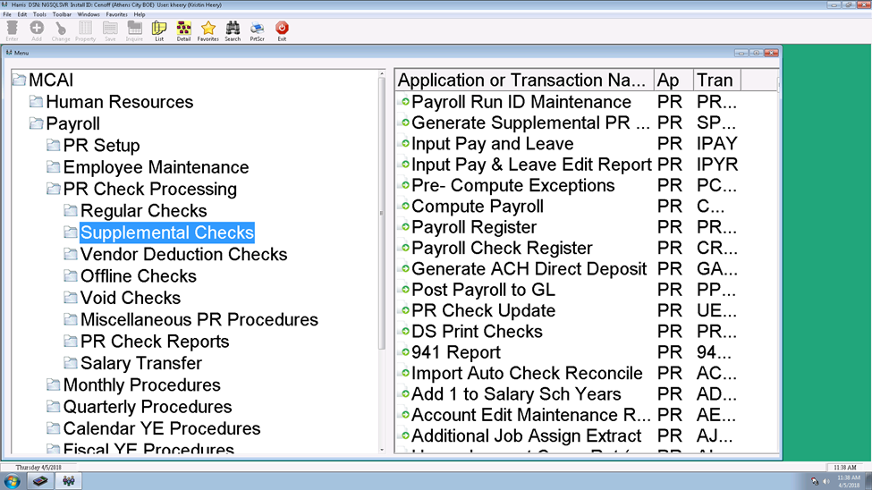
Payroll Run ID Maintenance

Slide 3
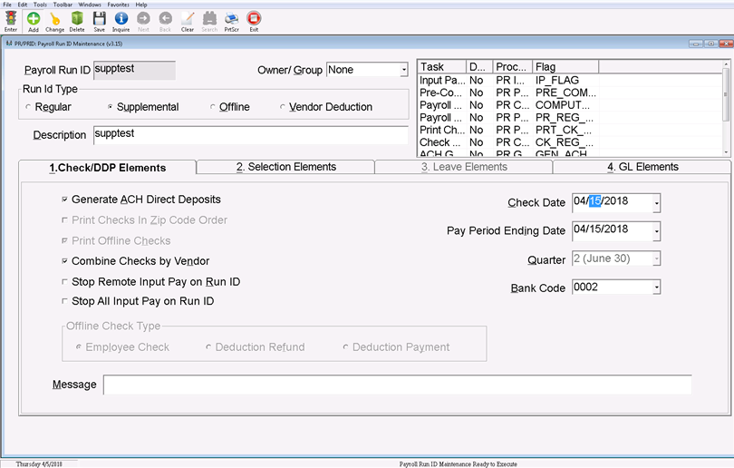
Set up Payroll ID

Slide 4
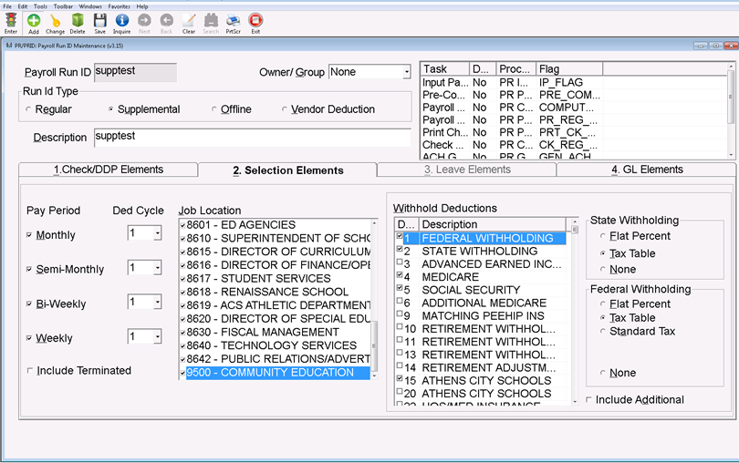
Set up Payroll ID – Tab 2

Slide 5
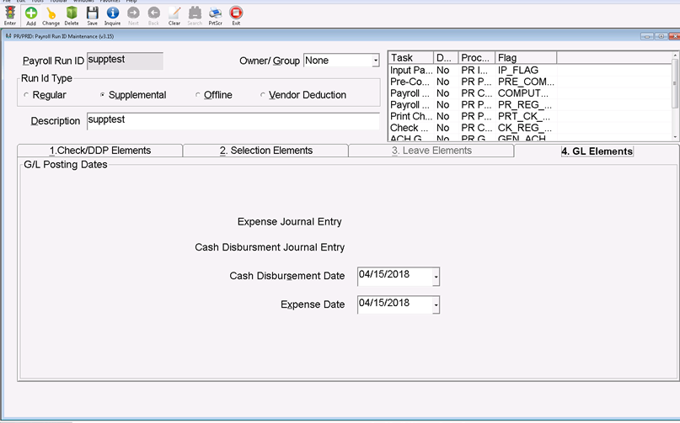
Set up Payroll ID – Tab 4

Slide 6
Complete the payroll as usual

Slide 7
When is supplemental pay needed?
Employee gate workers
Stipends
Summer School
Summer Camps
Academic/Athletic Supplements

Slide 8
Is that A/P or Payroll?
Reimbursement versus Allowance
Bonuses

Slide 9
Part 2
TAXABLE FRINGE BENEFITS
2018

Slide 10
IRS Publication 15-B for 2018
Employer’s Tax Guide to Fringe Benefits
Group-Term Life Insurance Coverage
Commuting Rule

Slide 11
Group-Term Life Insurance Benefits
TEACHERS’ RETIREMENT SYSTEMS OF ALABAMA
The beneficiary(ies) or estate of a deceased full-time active member or a full-time member who dies within 90 days of being in active pay status is eligible to receive $15,000.00 in life benefits.
This group-term life is a taxable fringe benefit that employees pay to have this benefit.
The cost of this term life is based on a cost per $1,000.00 of protection, wages, and age.

Slide 12
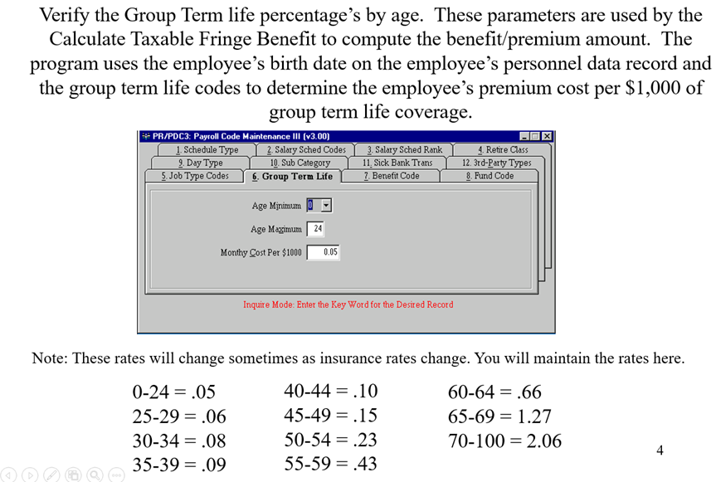
Payroll Code Maintenance III – Tab 6

Slide 13
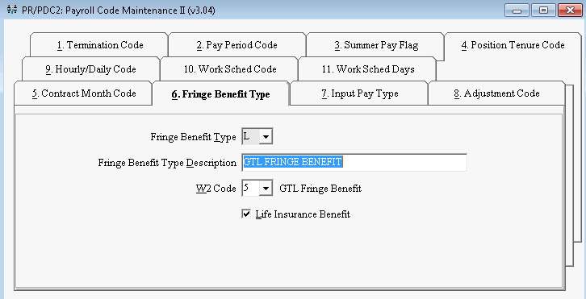
Payroll Code Maintenance II – Tab 6

Slide 14
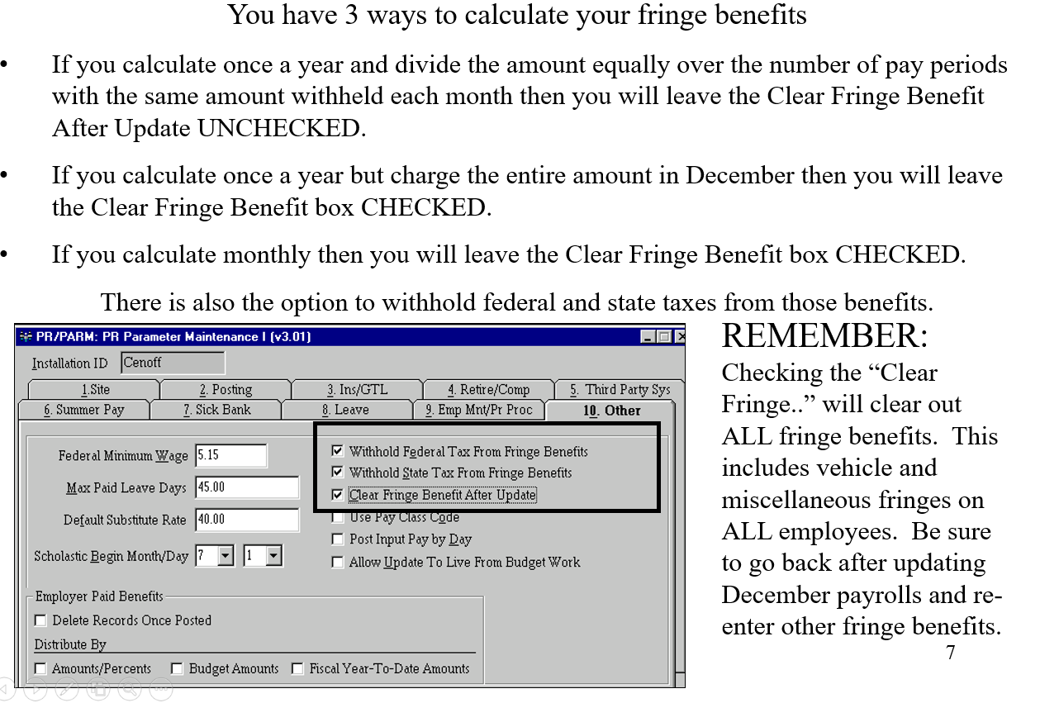
PR Parameter Maintenance I – Tab 10

Slide 15
Other items the Calculate Fringe Benefit program looks at
Employee had to have Retirement Deductions in the PR Check History for the period being reported.
Salaried Periods must be > 0
Job cannot be marked as NO Pay
Enrolled in DROP (State Specific Screen, Alabama sites only) may not be checked
Employee must have an Original Hire Date on the Employee Data Screen

Slide 16
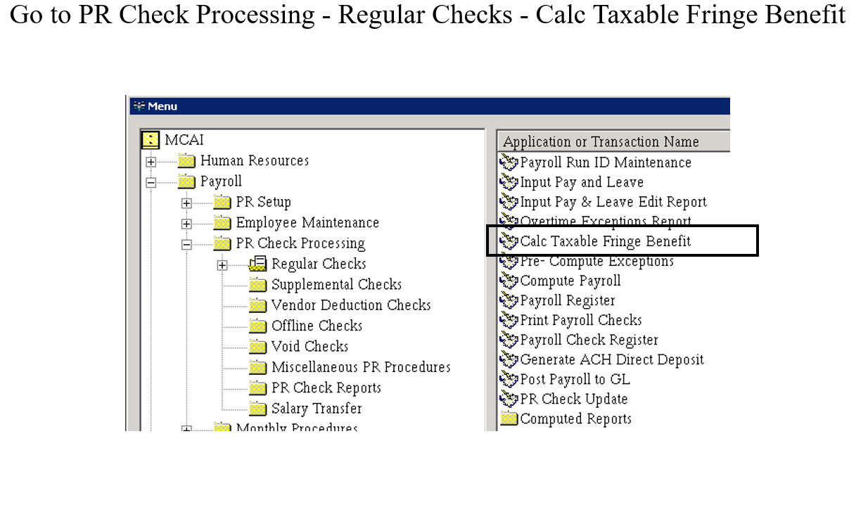
After the parameters are verified

Slide 17
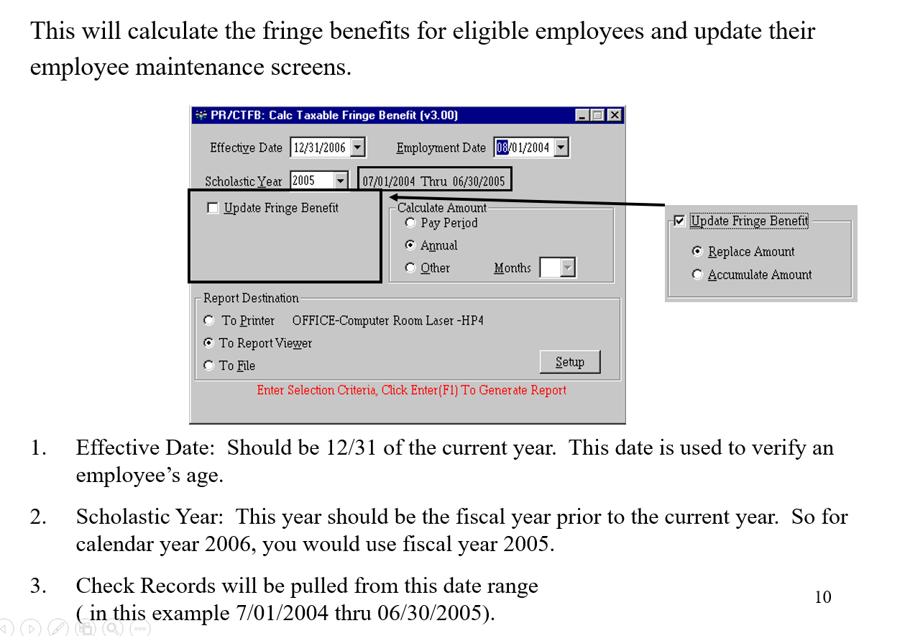
Calculate Taxable Fringe Benefit

Slide 18
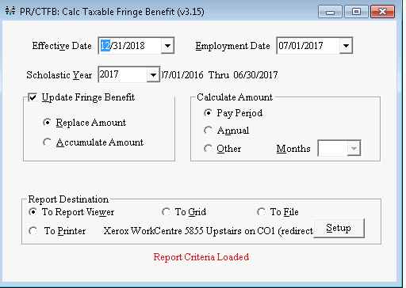
Example for Current Year

Slide 19
Vehicle – Commuting Rule
Vehicle Fringe Benefit:
Under the Commuting Rule, you determine the value of a vehicle you provide to an employee for commuting use by multiplying each one-way commute (home to work or work to home) by $1.50. If the employee commutes both ways, it will be $3.00 per day.
This will be any Board vehicle driven for commuting. This can be drivers education, transportation, and maintenance vehicle.
Example: $3.00 Round Trip
x 180 Days Driven
$540.00 / 12 months = $45.00 per month (Taxable Fringe)
$3.00 x 240 Days Driven = $720.00 / 12 months = $60.00 per month

Slide 20
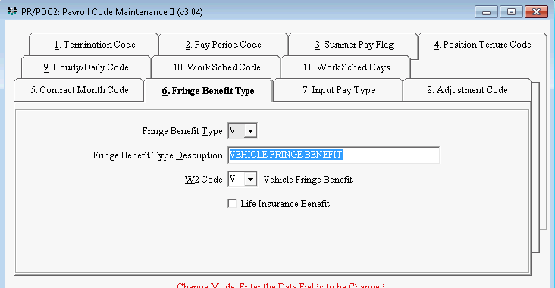
Payroll Code Maintenance II – Tab 6

Slide 21
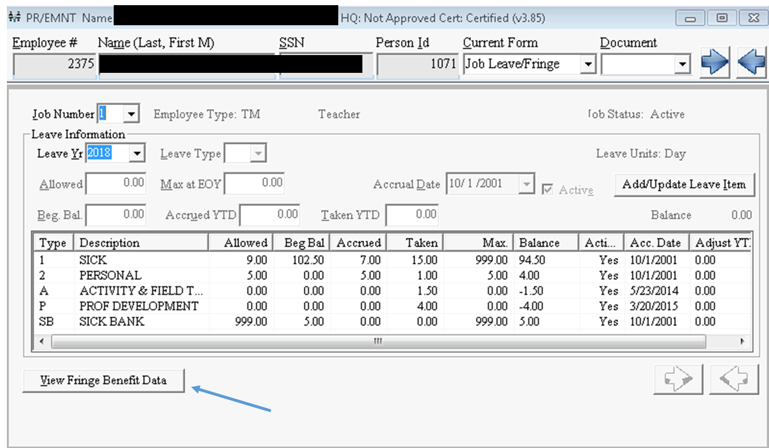
Employee Maintenance –
Job Leave/Fringe

Slide 22
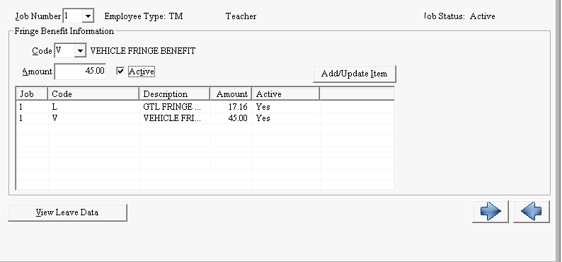
View Fringe Benefit Data

Slide 23

Questions

